Slide 1
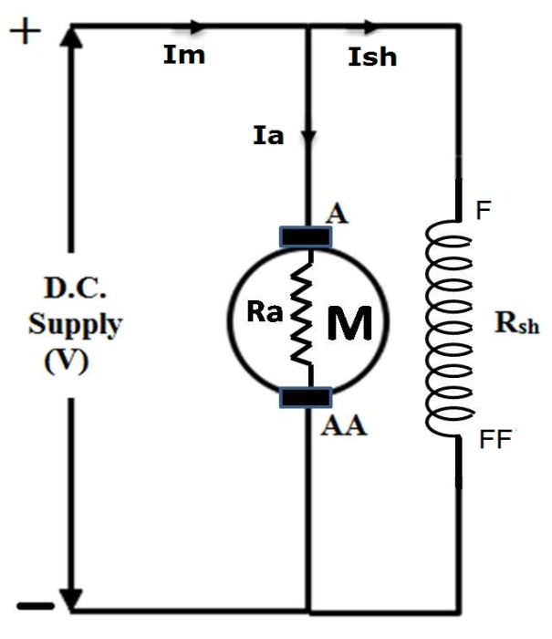
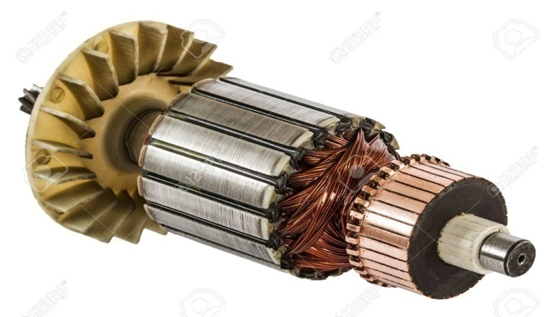
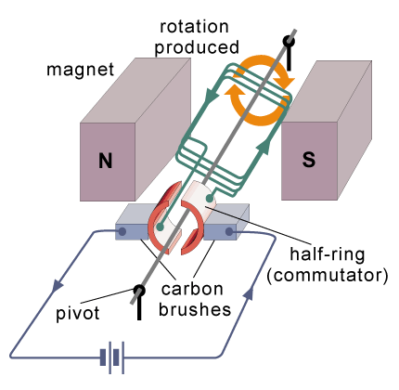
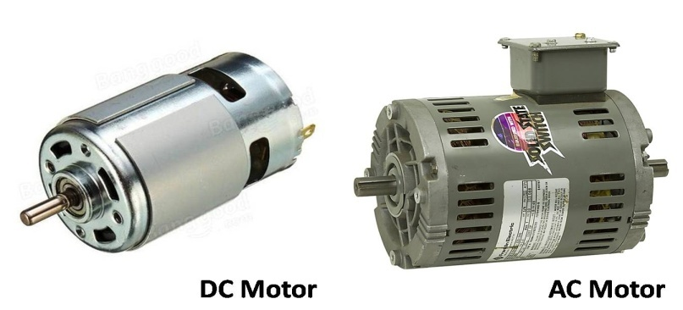
N
F
Actuators – 3.3
DC Brush Motors
FY – DESH – VIT
F
S
Vishwakarma Institute of Technology
FY - Department of Engineering, Sciences and Humanities
A Couple is generated

Slide 2
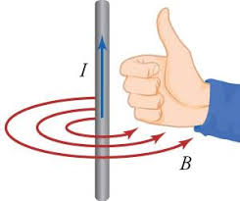
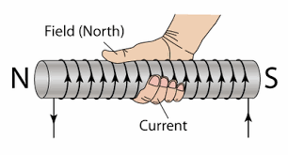
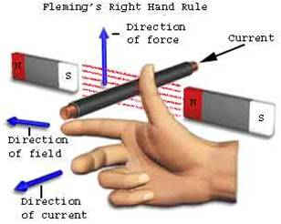
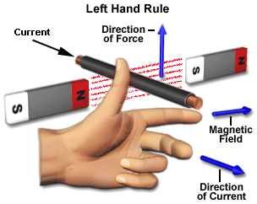
1) Right hand thumb rule – Relation between Magnetism and Current
Thumb is for Current OR Flux ?
Which figure is correct ?
2) Right hand rule – Generating action
3) Left hand rule – Motoring action
Vishwakarma Institute of Technology
FY - Department of Engineering, Sciences and Humanities

Slide 4
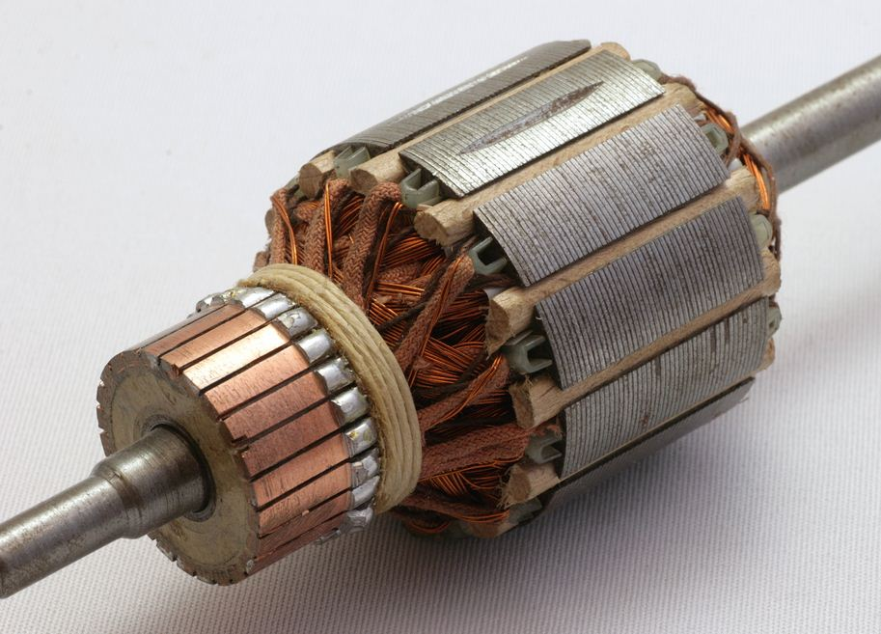
Armature
Shaft
Slots
Commutator
Vishwakarma Institute of Technology
FY - Department of Engineering, Sciences and Humanities
Armature Winding

Slide 5
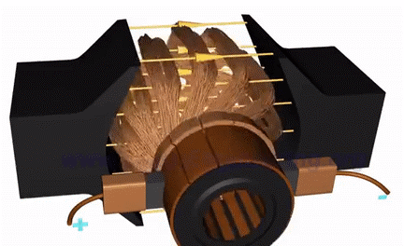
Armature Winding
Pole 2
Pole 1
Vishwakarma Institute of Technology
FY - Department of Engineering, Sciences and Humanities
Brushes
Commutator
+ External DC supply connections –

Slide 6
Vishwakarma Institute of Technology
FY - Department of Engineering, Sciences and Humanities

Slide 7
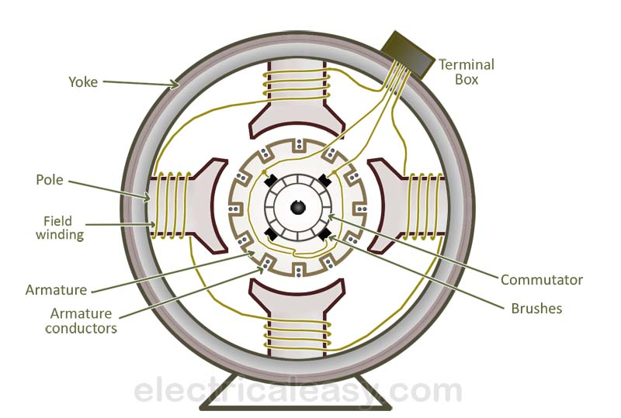
Construction of DC Machine
Vishwakarma Institute of Technology
FY - Department of Engineering, Sciences and Humanities

Slide 8
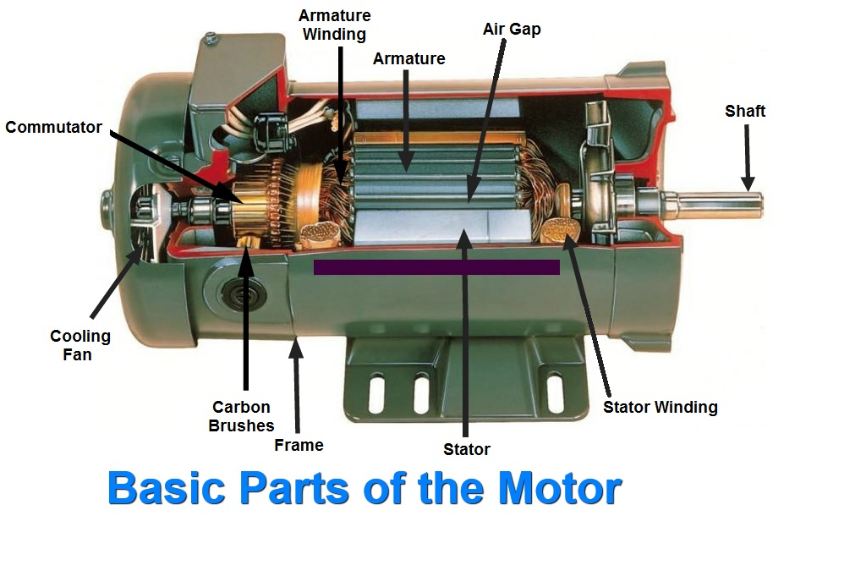
Construction of DC Machine
Vishwakarma Institute of Technology
FY - Department of Engineering, Sciences and Humanities

Slide 9
EMF Equation of a DC Generator .....
P = Number of poles of the machine.
ϕ = Flux per pole in Weber.
N = Speed of Armature in Revolutions per Minute (RPM).
Z = Total number of Armature conductors.
A = Number of Parallel paths in the Armature winding.
N
According to Faradays Law,
dϕ
e = ------ Volts
dt
Total Flux cut
e = ------------------ Volts
Time required
Vishwakarma Institute of Technology
FY - Department of Engineering, Sciences and Humanities
S
In one Revolution of the armature,
the total flux cut by one conductor will be
e = P ϕ Weber ......(eq.1)
RPM = Revolutions per Minute = N
RPS = Revolutions per Second = N / 60
Seconds for one Revolution = 60 / N .......(eq.2)

Slide 10
EMF Equation of a DC Generator .....contd.
According to Faradays Law,
Total Flux cut
e = ------------------ Volts
Time required
Substituting from eq.1) and eq.2) we get,
Total Flux cut P ϕ P ϕ N
e per conductor = ----------------- = -------- = --------- Volts
Time required 60 / N 60
There are total Z conductors, but all of them are not in series !
They are equally divided in A parallel paths (groups). Thus Z/A conductors are in series. Thus,
Vishwakarma Institute of Technology
FY - Department of Engineering, Sciences and Humanities
P ϕ N Z P ϕ N Z
Total E = ------- x --- = ---------- Volts
60 A 60 A
This is called as the EMF Equation of a DC Generator.
All other parameters are constant
E α ??
E α φ N

Slide 11
Left hand rule – Motoring action
Vishwakarma Institute of Technology
FY - Department of Engineering, Sciences and Humanities

Slide 12
A Couple is generated
Motoring Action – How a DC motor works ?
Main Flux
N
N
Dense Flux
Weak Flux
F
Armature Flux
Vishwakarma Institute of Technology
FY - Department of Engineering, Sciences and Humanities
F
S
S
Main Flux

Slide 13
Concept of Back EMF
Main Flux
When a motor starts rotating, the conductors cut the main flux in the air gap.
N
This cutting of Flux gives rise to an EMF in the conductors. (Generating action)
This EMF should oppose the cause producing it. (Lenz’s Law)
This EMF opposes the cause i.e. the supply voltage V.
Vishwakarma Institute of Technology
FY - Department of Engineering, Sciences and Humanities
Therefore this EMF is called as Back EMF (Eb) or Counter EMF.
S
Thus, V = – Eb
V is supply voltage and
Eb is generated EMF.
Main Flux

Slide 14
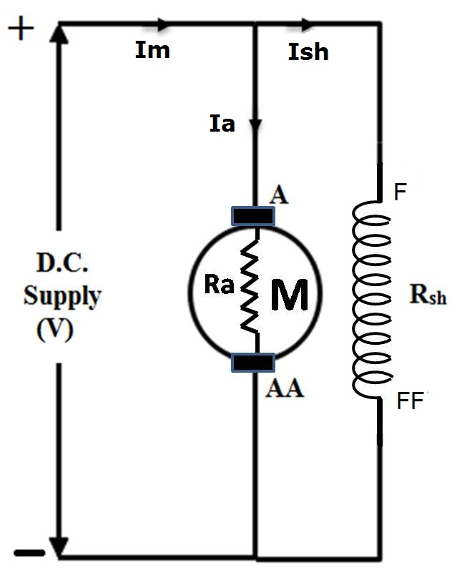
DC Shunt Motor
Im – Ish = Ia
V – Ia Ra = Eb
Some typical practical values of different parameters of a DC shunt motor are …..
V = 230 V DC
Im = 10 A (depends upon HP)
Ia = 9 Amp
Ish = 1 Amp
Ra < 1.0 ohm
Rsh = 200+ ohm
V drops at brushes also.
Eb = 227 ∼ 228 V
Vishwakarma Institute of Technology
FY - Department of Engineering, Sciences and Humanities

Slide 15
Eb = V – Ia Ra ….. Multiply both sides by Ia
Eb Ia = V Ia – Ia² Ra …….(1)
This is a power equation now…
Eb Ia = Input – Loss (Heat generated)
Thus…… Eb Ia = Output (IMP parameter)
But Eb = P φ N Z / 60 A ….. Substitute in (1)
P φ N Z
Eb = ----------- x Ia = T x ω …(Elect to Mech) 60 A
But ω = 2π N / 60
This is called as the Torque equation of DC Motor
T α φ Ia …(Other parameters are constant)
Vishwakarma Institute of Technology
FY - Department of Engineering, Sciences and Humanities
1 P φ Z Ia
Thus….. T = ------ x ------------- N-m
2 π A

Slide 16
P φ N Z
Eb = ----------- (basically Eb is a generated EMF)
60 A
Eb α φ N
N α Eb / φ
Vishwakarma Institute of Technology
FY - Department of Engineering, Sciences and Humanities
Eb V – Ia Ra
N α ------- = --------------
ϕ ϕ

Slide 17
Effect of loading on the motor speed
V – Ia Ra
N α -------------
ϕ
When Motor is loaded, it will take more current from supply and the speed has to drop because of loading.
Vishwakarma Institute of Technology
V – Ia Ra
N α -------------
ϕ
When Motor is unloaded, it will take less current from supply and the speed has to rise.
FY - Department of Engineering, Sciences and Humanities

Slide 18
Direction of rotation of DC motor
Main Flux
Assume that the motor starts and goes through 180⁰ of rotation.
N
So, what is the new direction ????
Same or Reversed ????
Vishwakarma Institute of Technology
FY - Department of Engineering, Sciences and Humanities
S
Main Flux

Slide 19
How do we get a unidirectional rotation ?
Main Flux
N
When a DOT goes from N to S, it no more remains DOT when it reaches S.
Rather it reverses the direction of current through itself and becomes a CROSS.
Exactly opposite thing happens in case of the CROSS under S pole.
Vishwakarma Institute of Technology
FY - Department of Engineering, Sciences and Humanities
S
This amazing change takes place because the COMMUTATOR !
Main Flux

Slide 20
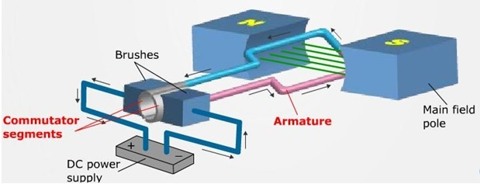
Vishwakarma Institute of Technology
FY - Department of Engineering, Sciences and Humanities
Commutator is divided into 2 halves called as segments.
Practically,
no. of segments = no. of slots in the armature

Slide 21
Vishwakarma Institute of Technology
FY - Department of Engineering, Sciences and Humanities
Practically,
no. of segments = no. of slots in the armature

Slide 22
Armature
Shaft
Slots
Commutator
Vishwakarma Institute of Technology
FY - Department of Engineering, Sciences and Humanities
Armature Winding

Slide 23
Vishwakarma Institute of Technology
FY - Department of Engineering, Sciences and Humanities

Slide 24
DC Motor characteristics –
Eb V – Ia Ra
N α ------- = --------------
ϕ ϕ
1
N α ------
Ia
1 P φ Z Ia
Thus….. T = ------ x -------------
2 π A
T α Ia
Vishwakarma Institute of Technology
FY - Department of Engineering, Sciences and Humanities
Characteristics are graphical relations between Ia, T and N

Slide 25
DC Motor characteristics –
1
N α ------
Ia
N
Ia
T α Ia
T
Vishwakarma Institute of Technology
FY - Department of Engineering, Sciences and Humanities
Ia
Draw a graph for the relation between T and N.
N
?
T

Slide 26
N
Actuators – 3.3
DC Brush Motors
Thanks !
FY – DESH – VIT
F
F
S
Vishwakarma Institute of Technology
FY - Department of Engineering, Sciences and Humanities
A Couple is generated

